Slide 1


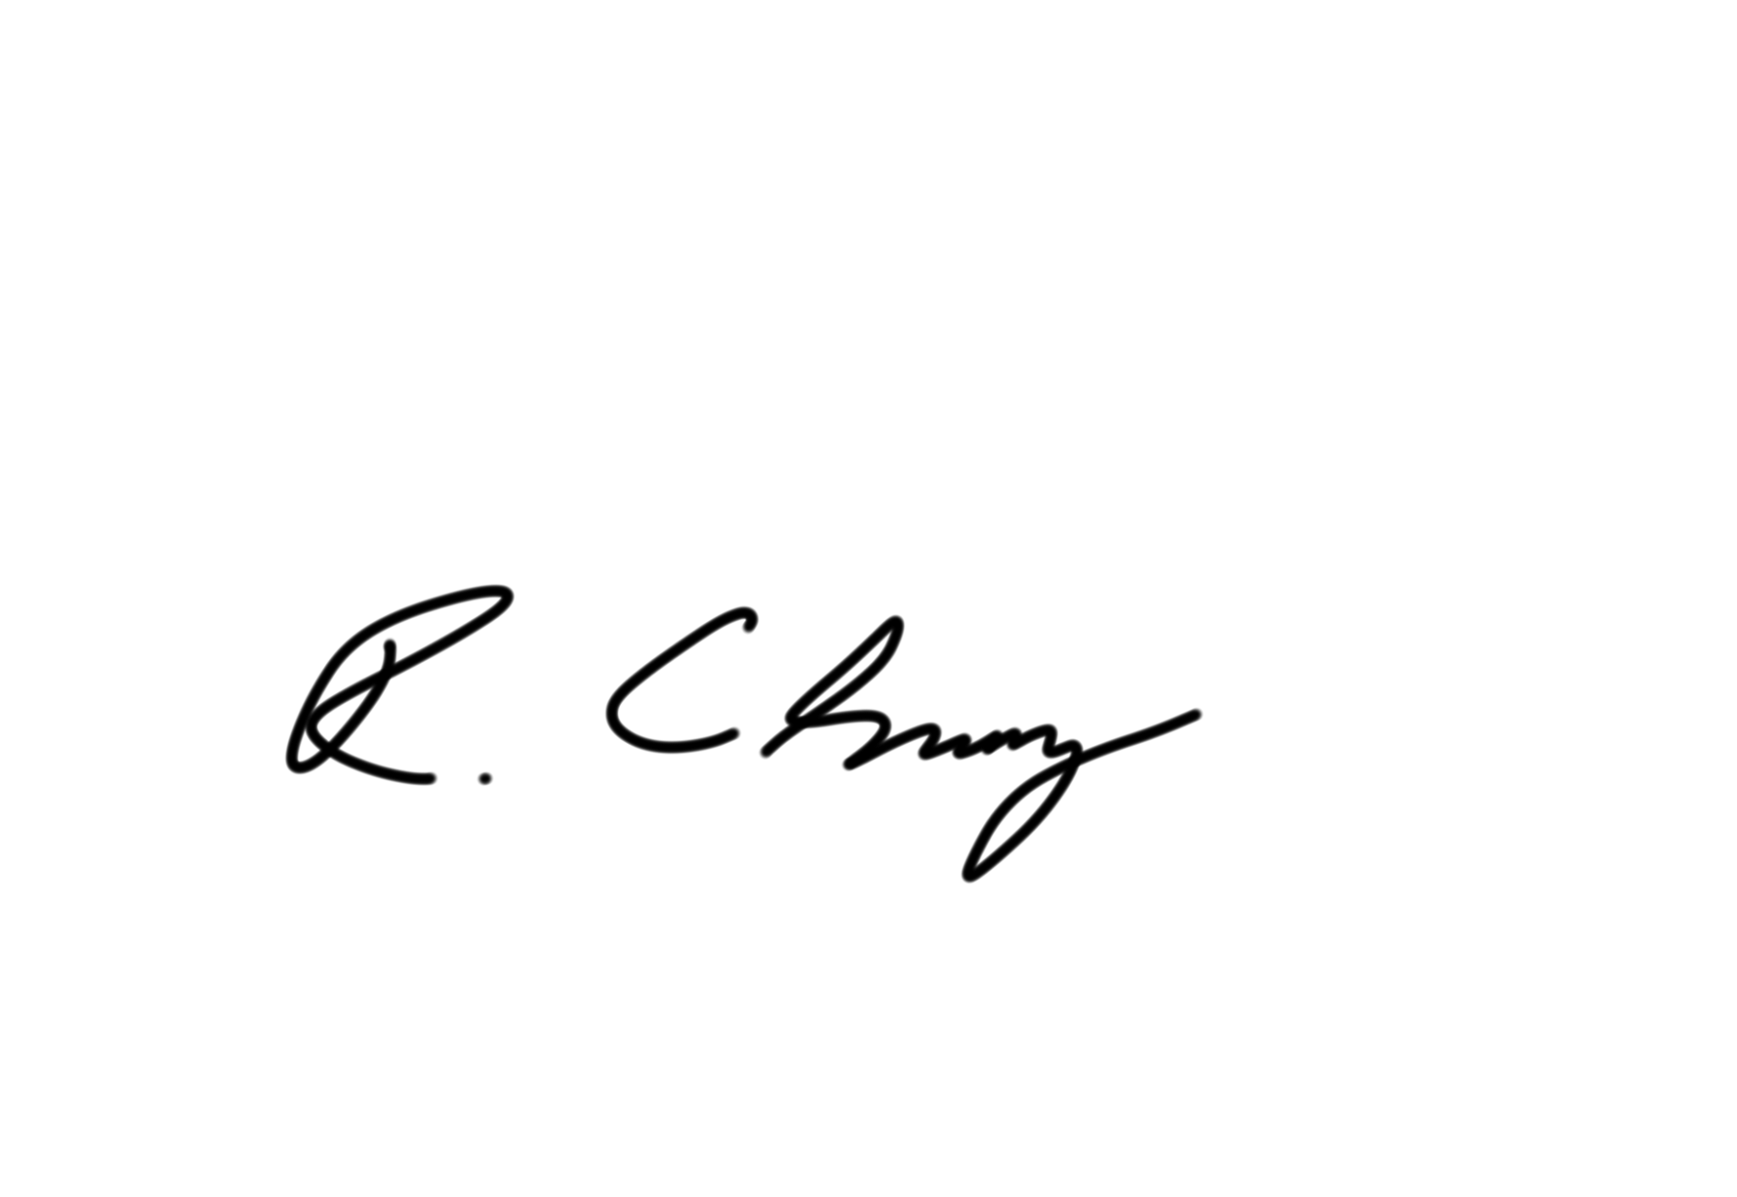
CERTIFICATE OF APPRECIATION
This certificate is proudly presented to:
Melvin Tai
in recognition of your contribution as a Sunway Student Ambassador in the
Sunway International Schools Open Day on 26th April 2025
Mr. Richard Cherry
Principal - Sunway International Schools

